Slide 1


Comparative analysis of
Urban vs. Suburban Usage
CSCI322 : DATA ANALYSIS
01

Slide 2


Team
members
Khaled Waleed Farouk
202000780
Eyad Yasser Badawi
202000517
Yusif Khaled Rashed
202001555
Mostafa Mohamed Assad
202000191
02

Slide 3

our
dataset
Study Scope
76 Days (March-May 2019
Three popular mobile applications analyzed: Google Play Store, Youtube and Instagram
geographical coverage
Urban Cities: Paris, Marseille and Lyon
Suburban Cities: Orleans, Mans and Nancy
03

Slide 4


our
goals
Identify Peak Usage Times
Optimize Pricing Strategies
Determine when users most actively engage with entertainment apps.
Provide insights for value-based advertisement pricing
models.
Map Geographic Usage Patterns
Improve Audience Targeting
Locate high-activity areas for targeted advertising
placement.
Reﬁne marketing outreach based on behavior patterns.
04
HOW DO APP USAGE PATTERNS DIFFER BETWEEN URBAN AND SUBURBAN AREAS?

Slide 5

our
methodology
Missing Value Handling
Data Structuring
Identiﬁed non-numeric traﬃc values.
Replaced with mean daily values.
Issue found on March 31, 2019 (4 consecutive hours)
Grouped by weekday.
Calculated average weekly patterns.
Heat map visualizations created.
Ensures complete dataset for analysis.
Enabled pattern identiﬁcation across cities.
Outlier Detection (IQR)
Calculated daily average traﬃc.
Q1 (25%) and Q3 (75%).
IQR = Q3 - Q1
Lower Bound = Q1 - 1.5 × IQR
Upper Bound = Q3 + 1.5 × IQR
05
Removed values outside bounds.

Slide 6
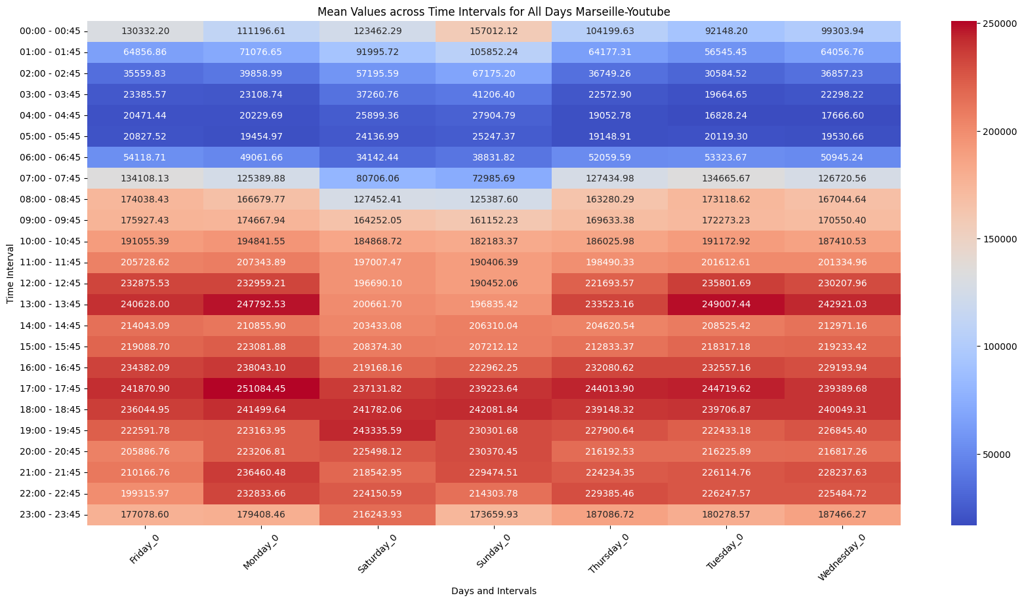
heatmap
results
06

Slide 7
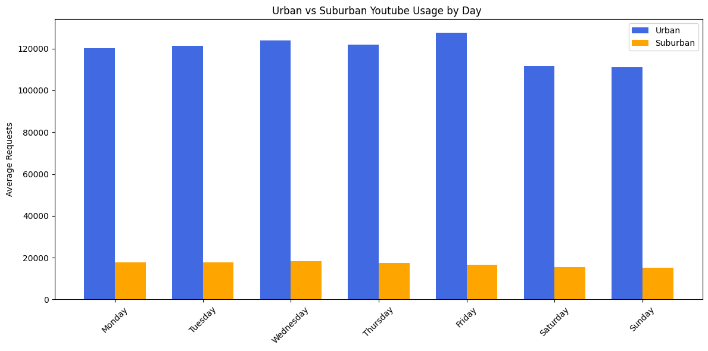
average
youtube
traffic comparison
07

Slide 8
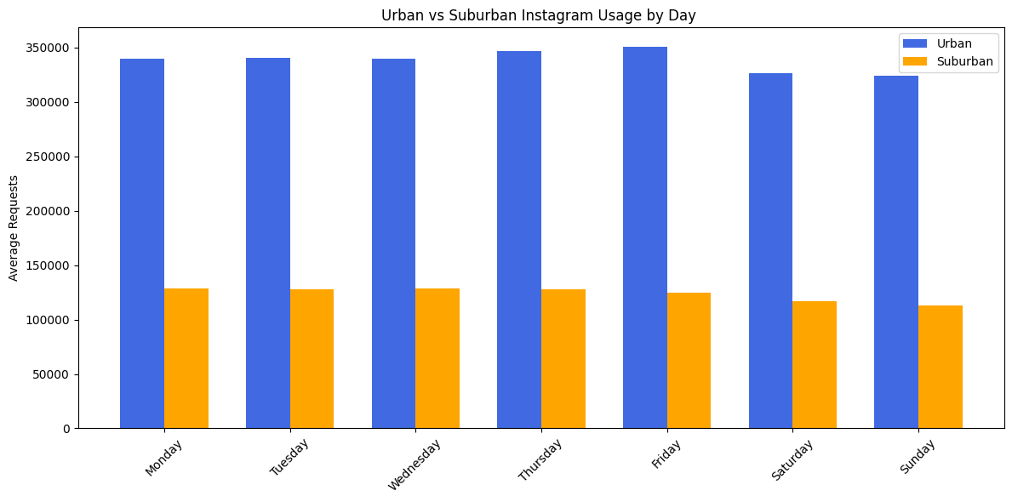
average
Instagram
traffic comparison
08

Slide 9
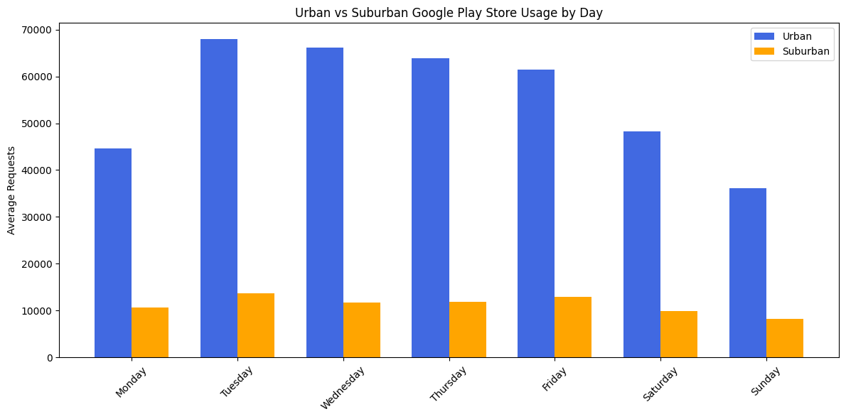
average
google ps
traffic comparison
09

Slide 10
Key Insights &
conclusions
Urban Usage Pattern
Suburban Usage Pattern
Marketing Implications
Clear midday activity peaks identiﬁed.
Concentrated traﬃc in speciﬁc zones.
Weekday usage exceeds weekend engagement.
Flatter, more consistent usage distribution.
Wider geographical spread of activity.
More consistent weekend usage observed.
Urban: Time-speciﬁc targeted campaigns eﬀective.
Suburban: Consistent all-day strategies preferred.
10

Slide 11

thank
you!
DATA ANALYSIS IS KEY TO BUSINESS GROWTH AND SUCCESS!
11

